Slide 1
Back to School Night
Da Vinci Communications
Fall 2014

Slide 2
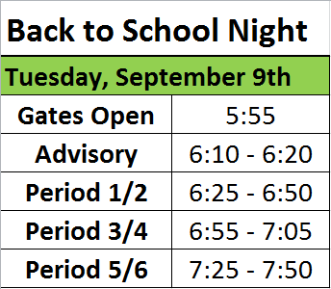
Student schedules are in advisory classes
Advisory rosters are outside classrooms and with Jackie

Slide 3
Service Hours
20 by the end of the year
10 by the end of first semester
Half of the advisory grade
* Up to 5 of the 20 hours may be done at Da Vinci. Students can of course volunteer more than 5 hours at DVC, but must do 15 outside of DVC by the end of the year.

Slide 4
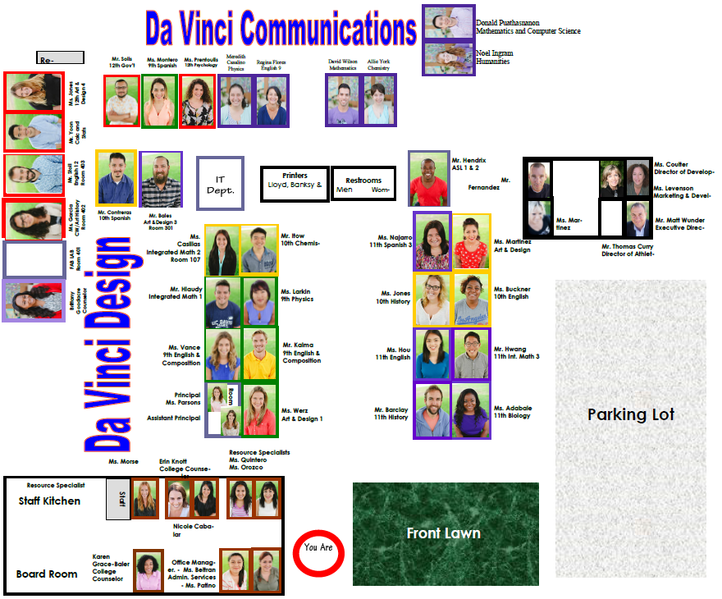

Slide 5
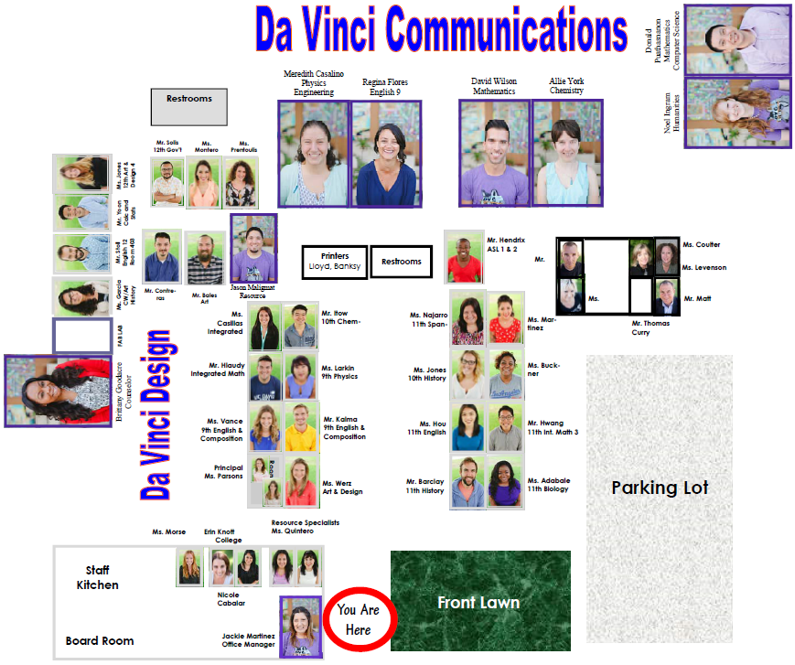

Slide 6
PowerSchool
https://davincischools.powerschool.com/
Check grades and attendance
Parent and student logins are the same

Slide 7
https://davincischools.powerschool.com/

Slide 8
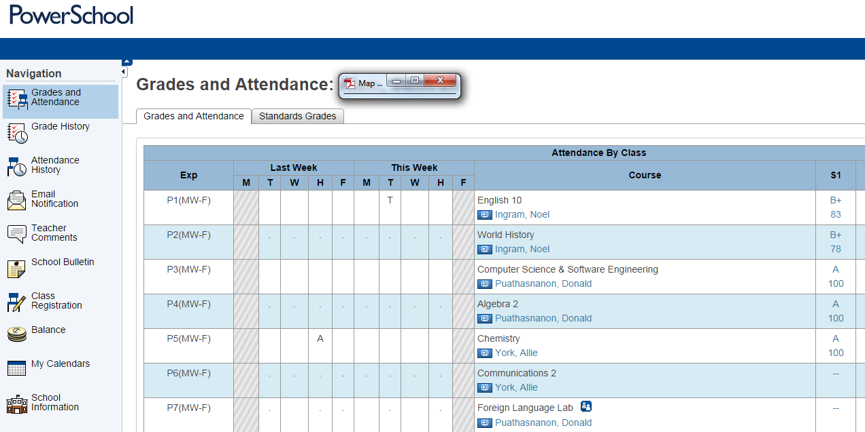
Click on a class’s grade to get more detailed assignment information

Slide 9
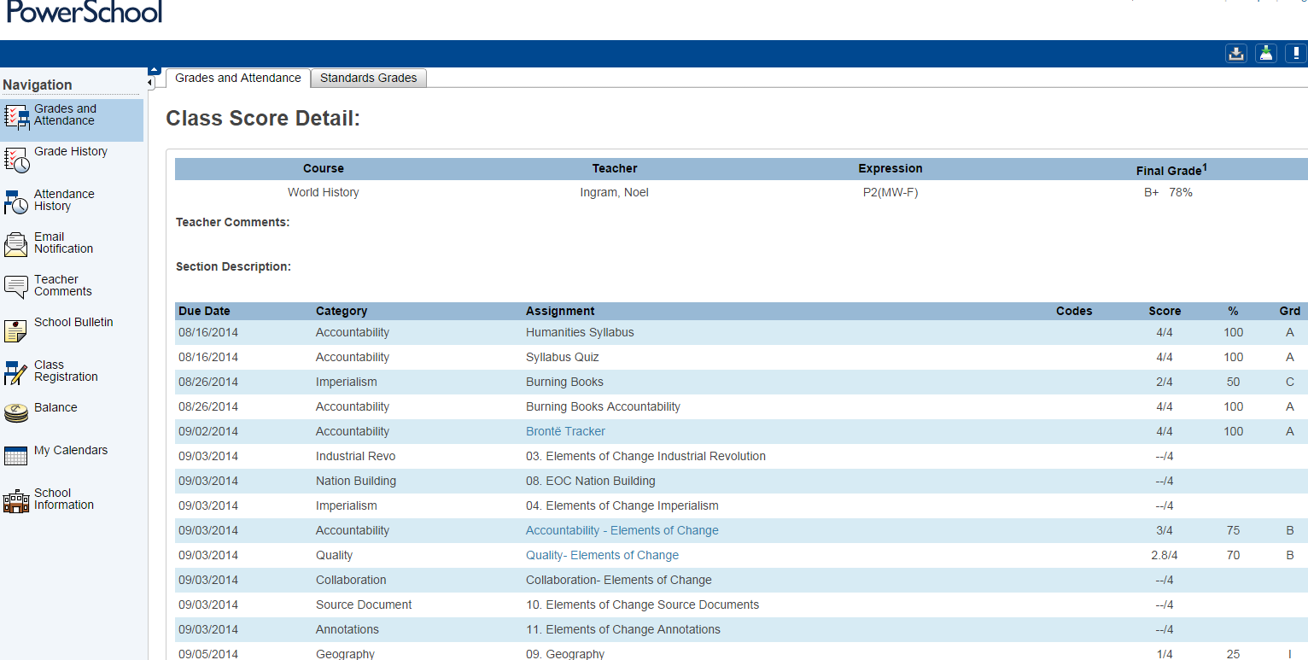
Overall grade
Assignments and grades
“--/4” means the teacher has not yet graded that assignment
“0/4” means an assignment is missing

Slide 10
Scores Are Out of 4!
2 out of 4 is a “C”
The percentage is non-traditional, don’t be distracted by that

Slide 11
Overall Percentages are Unfamiliar
Why is 78% a B?
3.12 average is a B
3.12 / 4 = 78%

Slide 12
